Slide 1

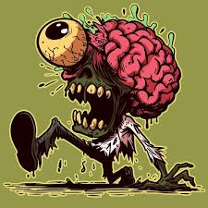

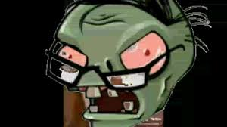


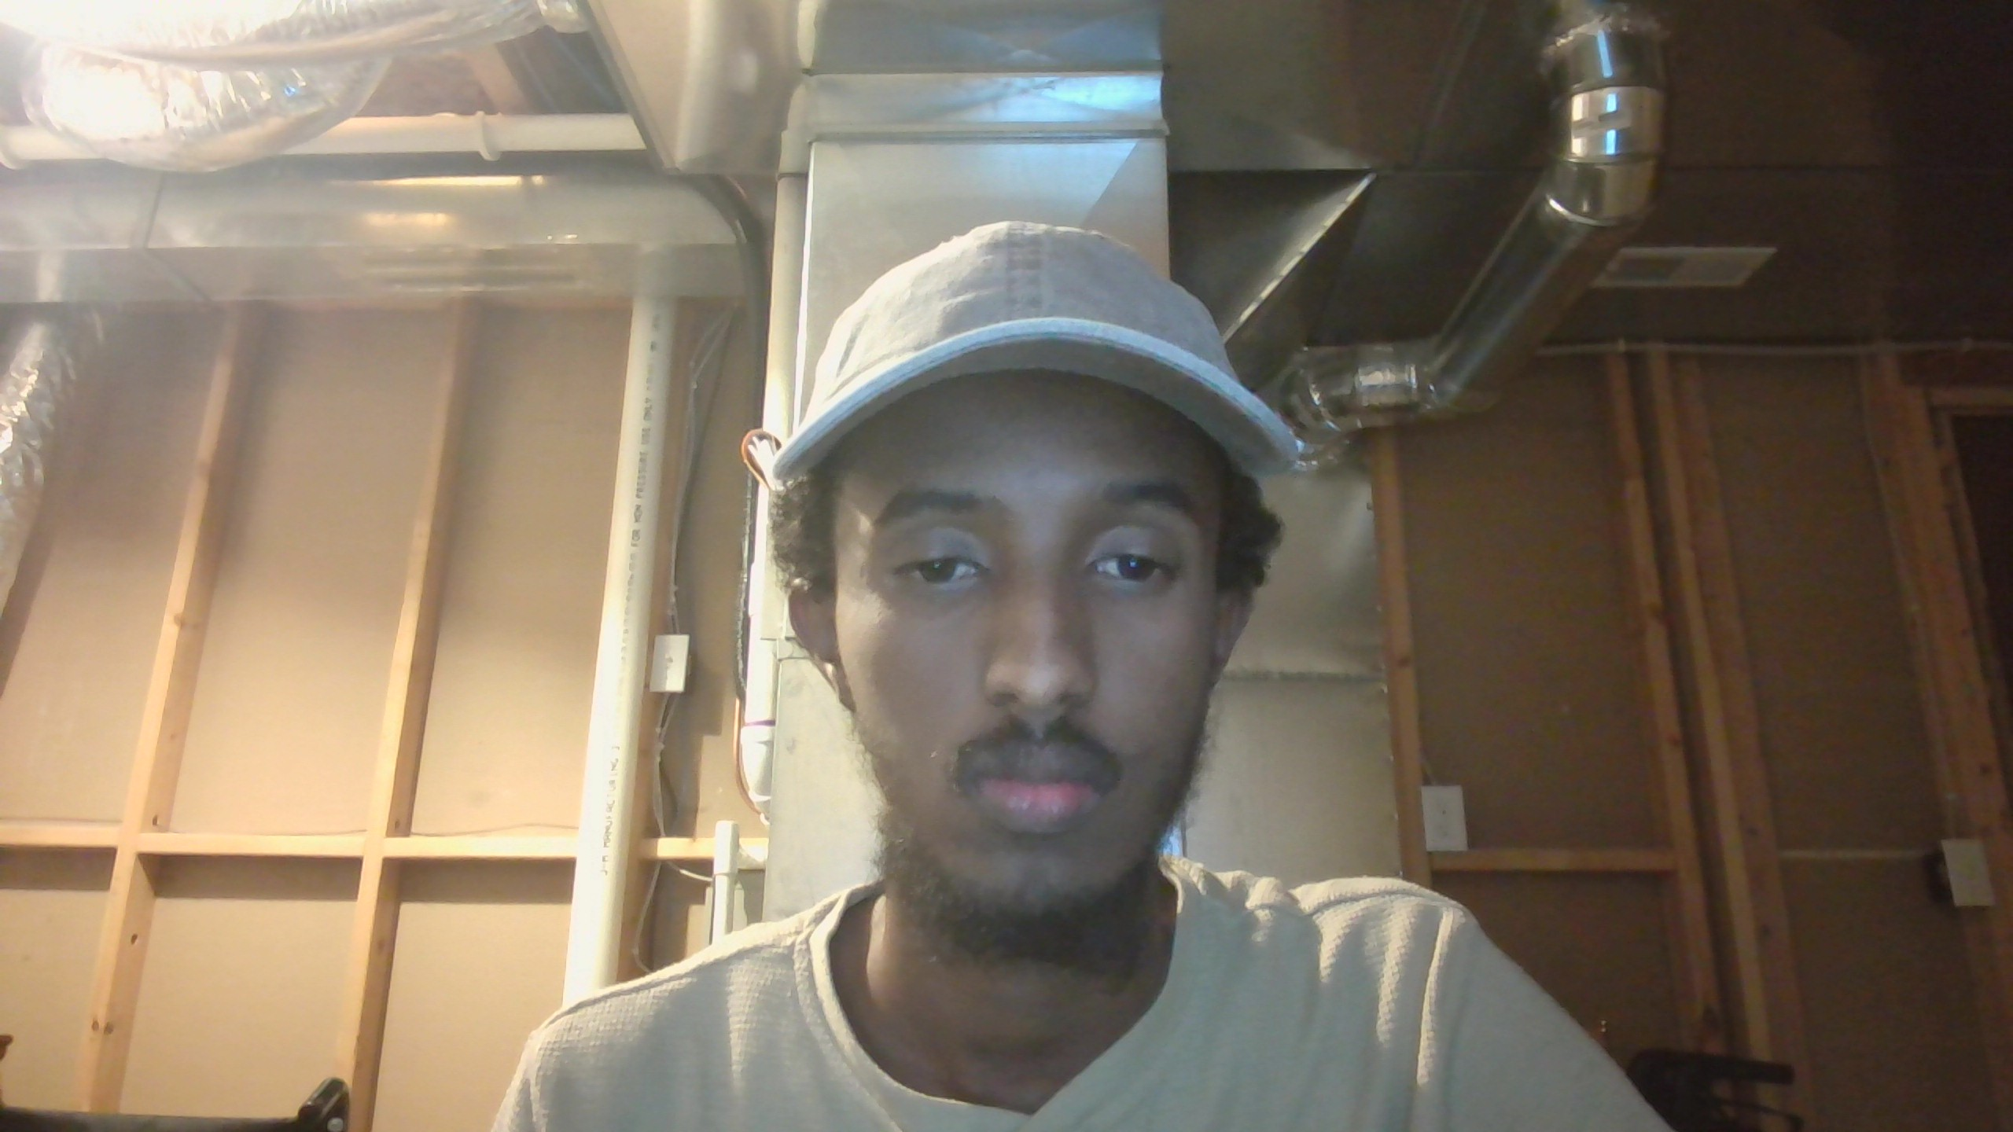

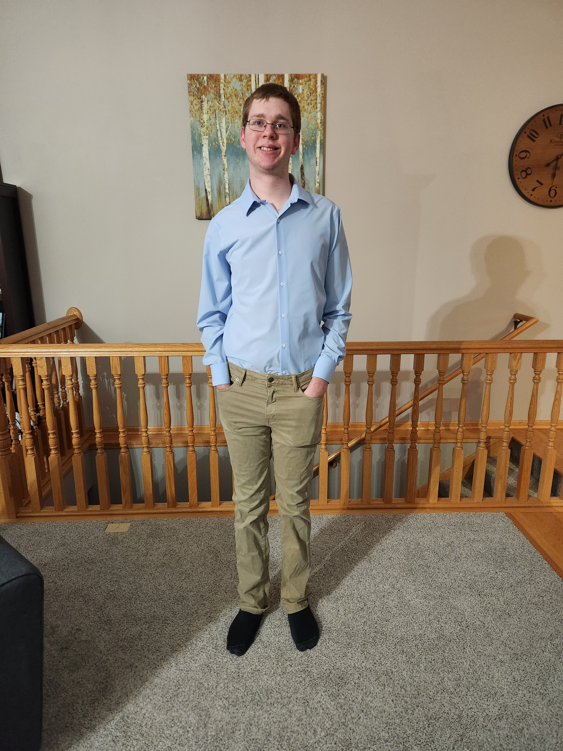
Zombie Apocalypse
By
Alex, Ashton, Jordin, Muse, and Arlo

Slide 2
Project Outline
This will be a database system that is used to keep track of the survivor static, their resources their tools, and their bases.
How each of this thing connect into a more grated function.
This database be used to help the survivors

Slide 3
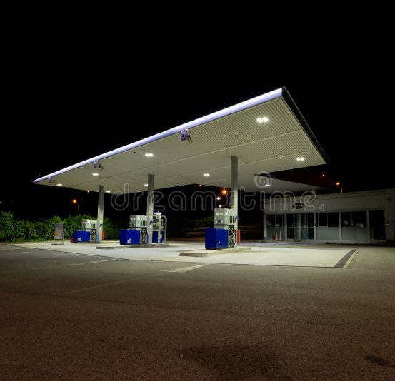
Problem
The main problem is the zombie, and the virus the zombie can spread to other survivors and animals. This mean there is a risk with every encounter with the cause one bite form a zombie could mean you are now a zombie.
This is one of the last working database system in the world and the people are tasked with keeping track of the survivors and their resources.
The survivors will have to be mindful of where they go so, they don't run into a zombie horde that they can't defeat.

Slide 4
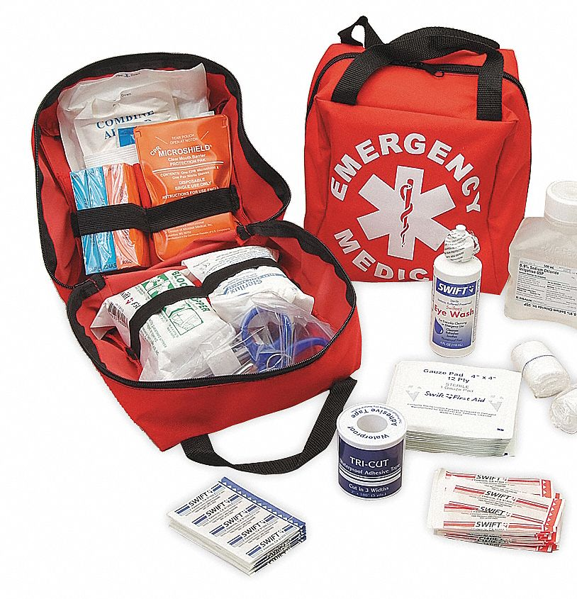
Solution Overview
Will make a database tracking the survivors if they are injured, need more food or water, what vehicles they have, what weapon do they have on them, what mission there one, and what their base is.
The amount of some of the resource they have will be tracked with the database like food, water, supplies and gas for the vehicles.
It will make sure the survivors are heathy and safe, so nobody lie and was infected by the zombie doom the base.

Slide 5
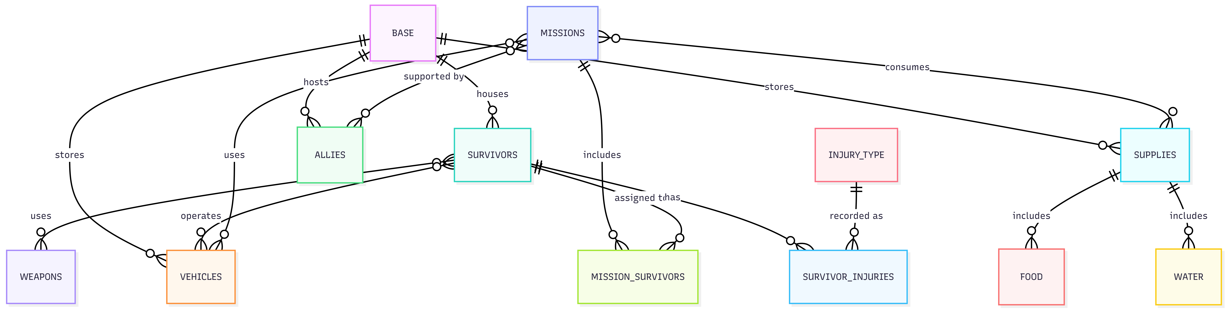
ERD

Slide 6
Data Integrity
Entity Integrity
Referential Integrity
Domain Integrity
User-Defined / Business Rule Integrity
Constraints in Action

Slide 7

Queries, Triggers, and Stored Procedures
To keep the work organized and consistent, query development was split among team members, with each person writing queries for the tables they were responsible for.
Injury Type table change

Slide 8

Arlo
Survivors
Weapons
Mission Survivors
Injury Types

Slide 9
Ashton – Mission and Allies
Structure
Missions track operations (type, status, dates, origin base).
Allies store external groups with trust level and optional base association.
Both tables use primary keys and foreign keys to Base for referential integrity.
Queries
Retrieve missions by status, base, and duration.
Analyze allies by trust level and base affiliation.
Support operational and strategic decision-making.
Stored Procedures
Enforce valid inserts (required fields, valid base references).
Mission status validated using a lookup table, not hardcoded values.
Prevents bad data before it enters the database.
Triggers
Act as a fail-safe for direct inserts or updates.
Block invalid mission statuses, date ranges, and missing values.
Ensure allies always have valid trust levels and base references.
Views
Simplify reporting and reuse:
Mission overviews and active missions
Completed mission durations
Ally overviews and high-trust allies
Improve readability without duplicating query logic.

Slide 10
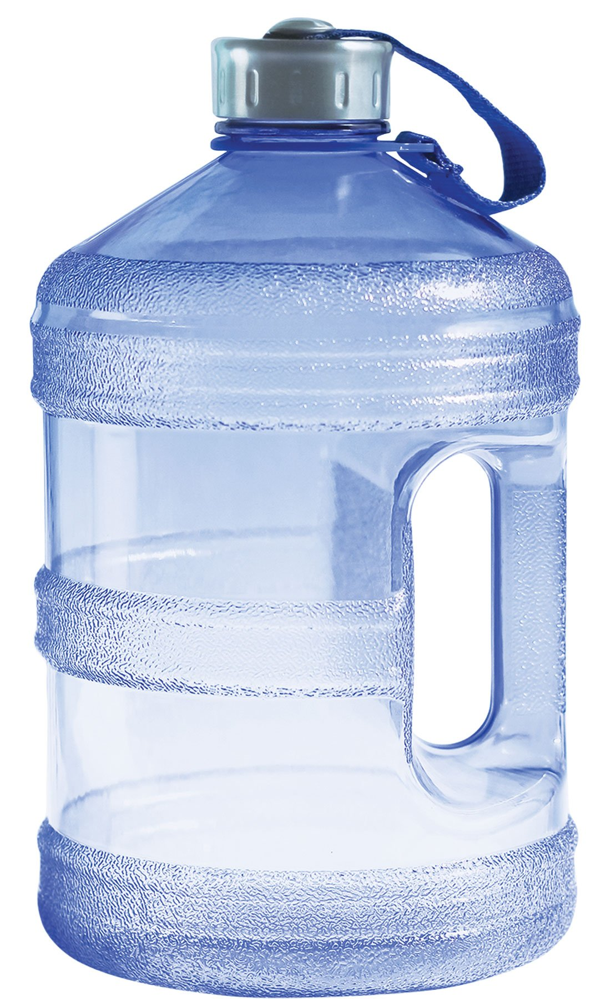
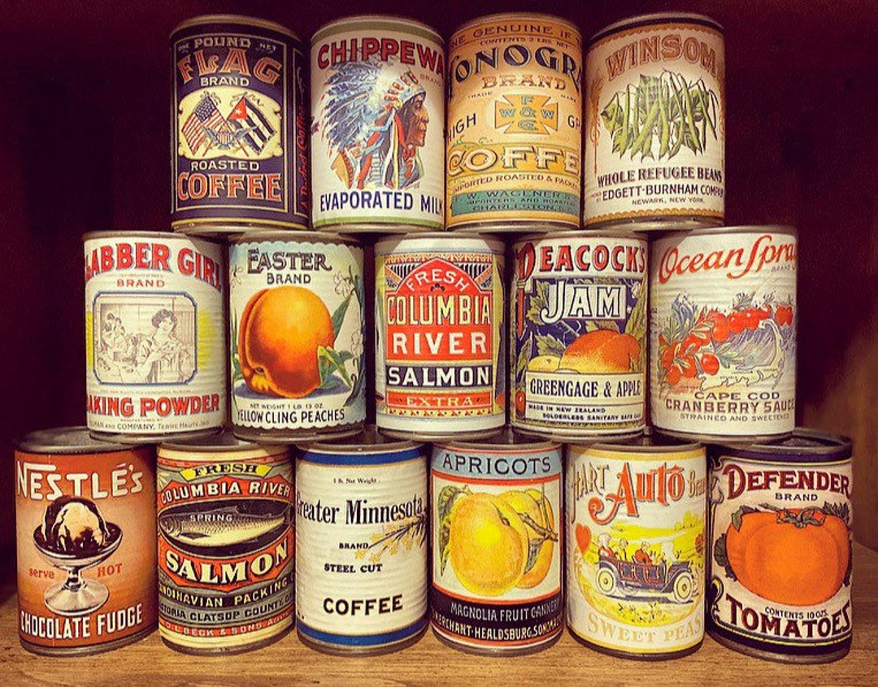
Alexander
Water
Food

Slide 11

Muse
Vehicles
Supplies

Slide 12

Jordin - Security

Slide 13
Project Results
Successfully designed and implemented a fully normalized relational database for a doomsday survival scenario.
Created a complete ERD that accurately models entities, relationships, and constraints.
Implemented stored procedures and triggers to validate data and protect integrity.
Developed queries and views to support reporting, analysis, and operational decision-making.
Produced a database that is scalable, consistent, and maintainable.

Slide 14

Lessons Learned
What we have learned from this group project.

